Slide 2


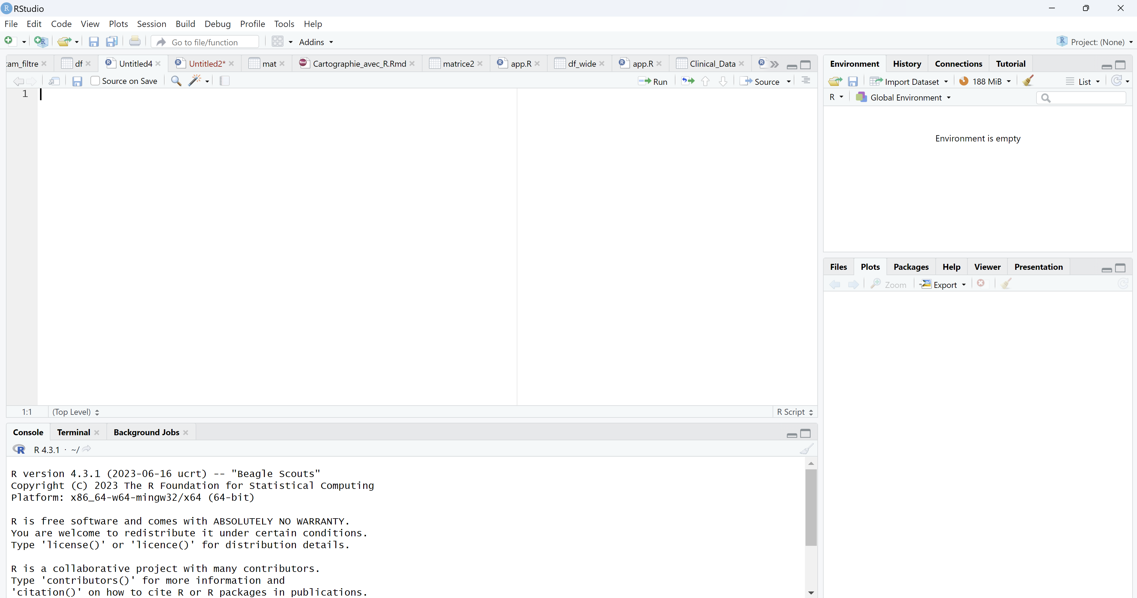
Introduction to R and RStudio
Brief overview of R:
Developed by Ross Ihaka and Robert Gentleman at the University of Auckland.
Widely used for statistical computing and graphics.
Open-source and highly extensible.
Introduction to RStudio:
Integrated Development Environment (IDE) for R.
Enhances productivity with a user-friendly interface.
Available in both open-source and commercial editions.
Introduction to RStudio:
Benefits of using R and RStudio:
Powerful for data analysis and visualization.
Active community and extensive package ecosystem.
Supports reproducible research with tools like RMarkdown.

Slide 3
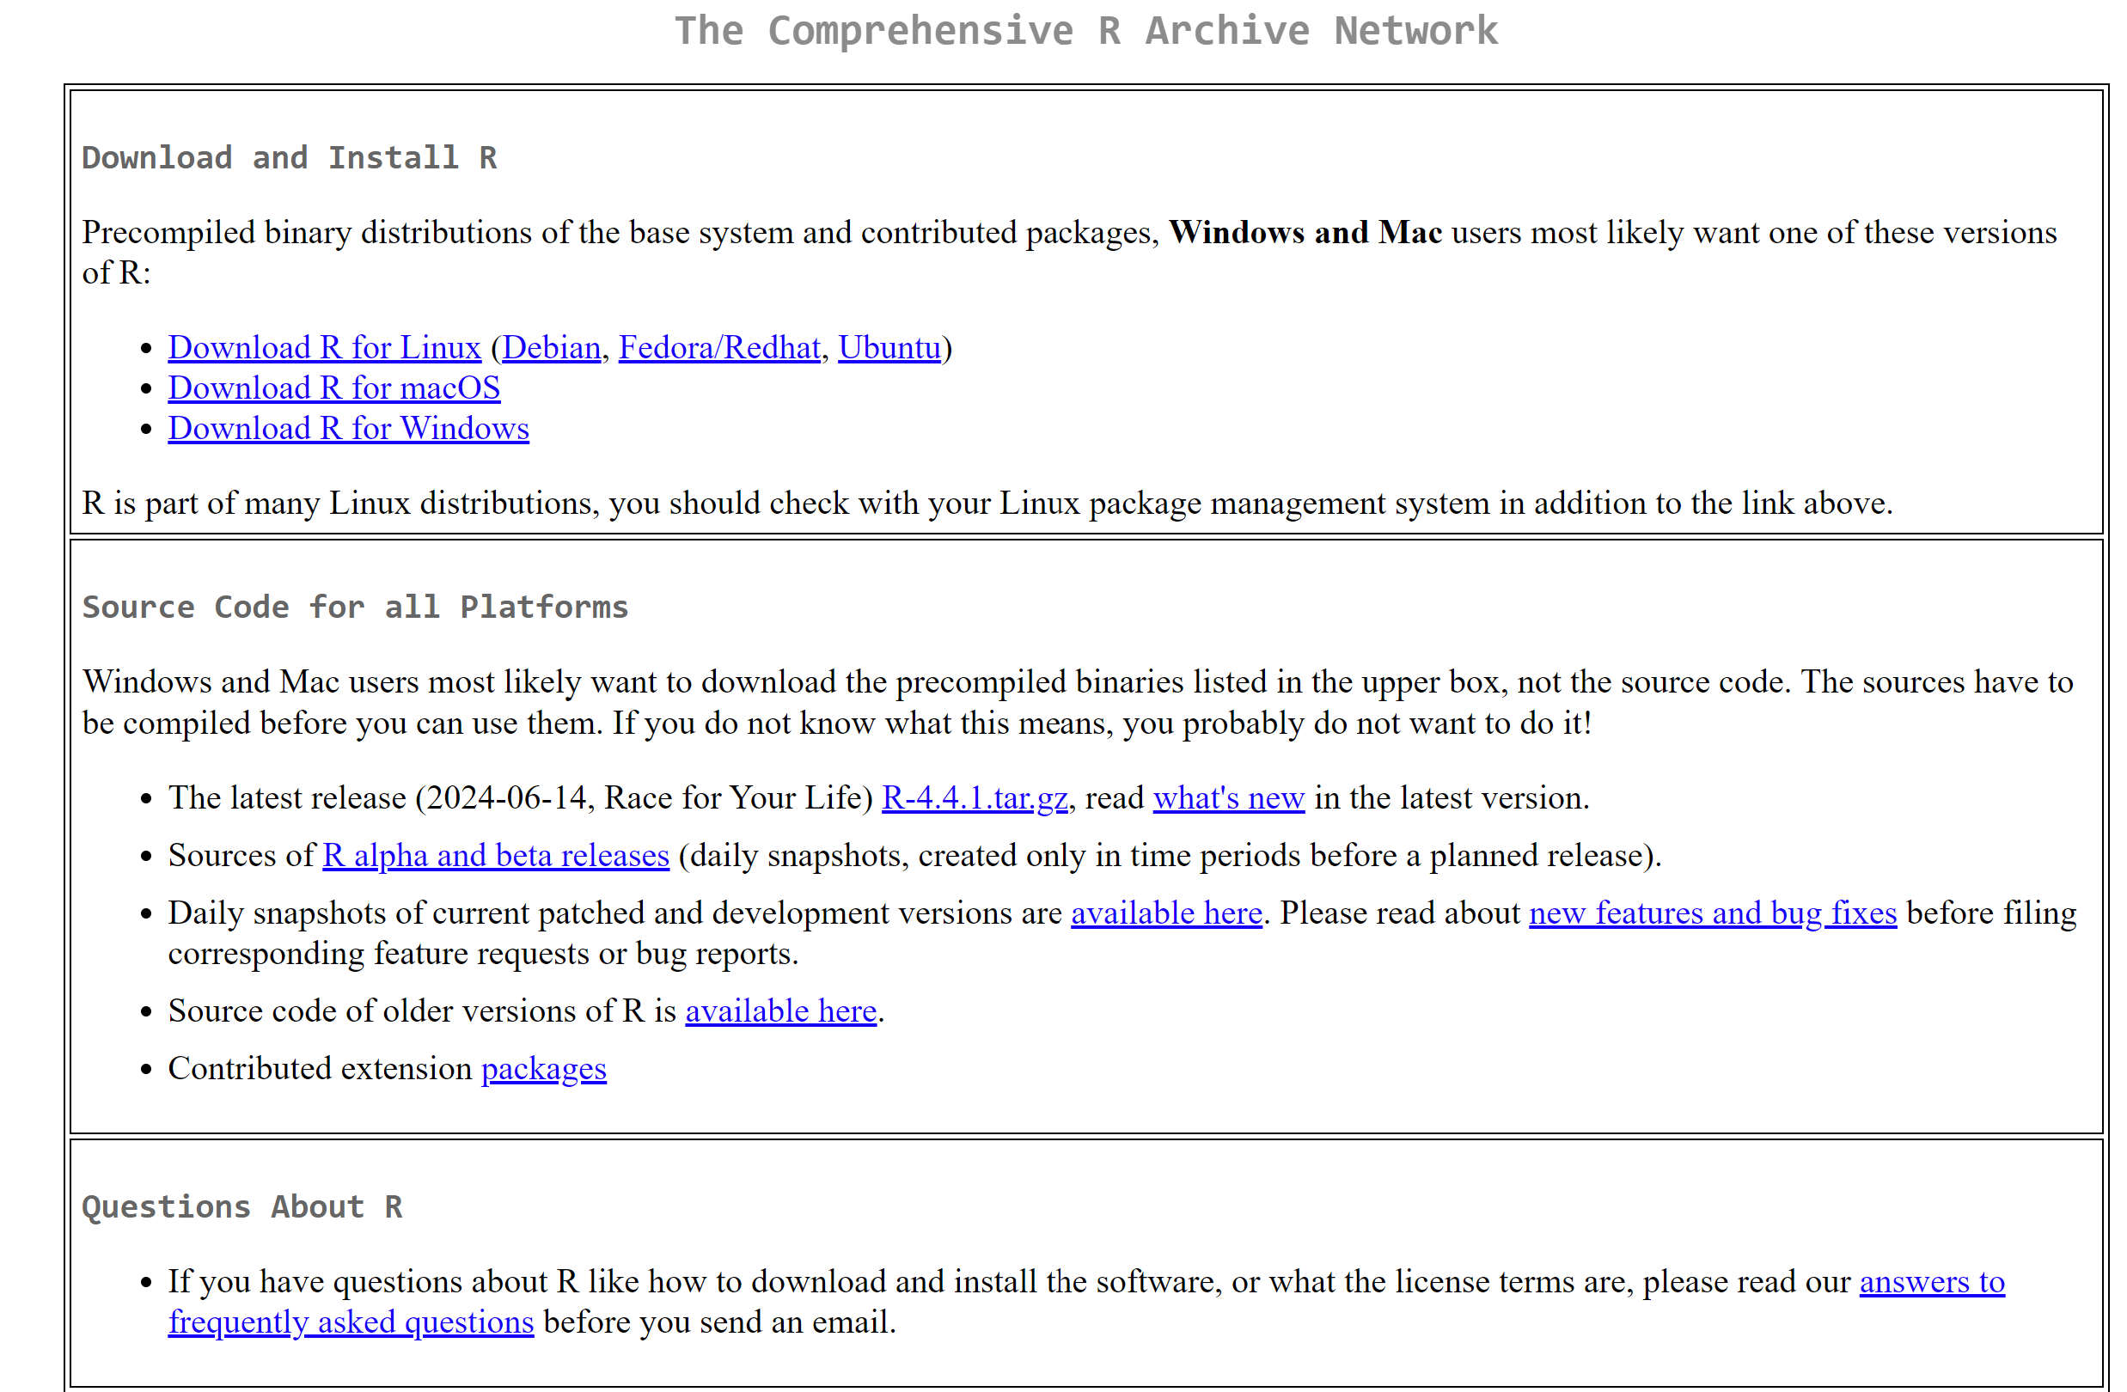
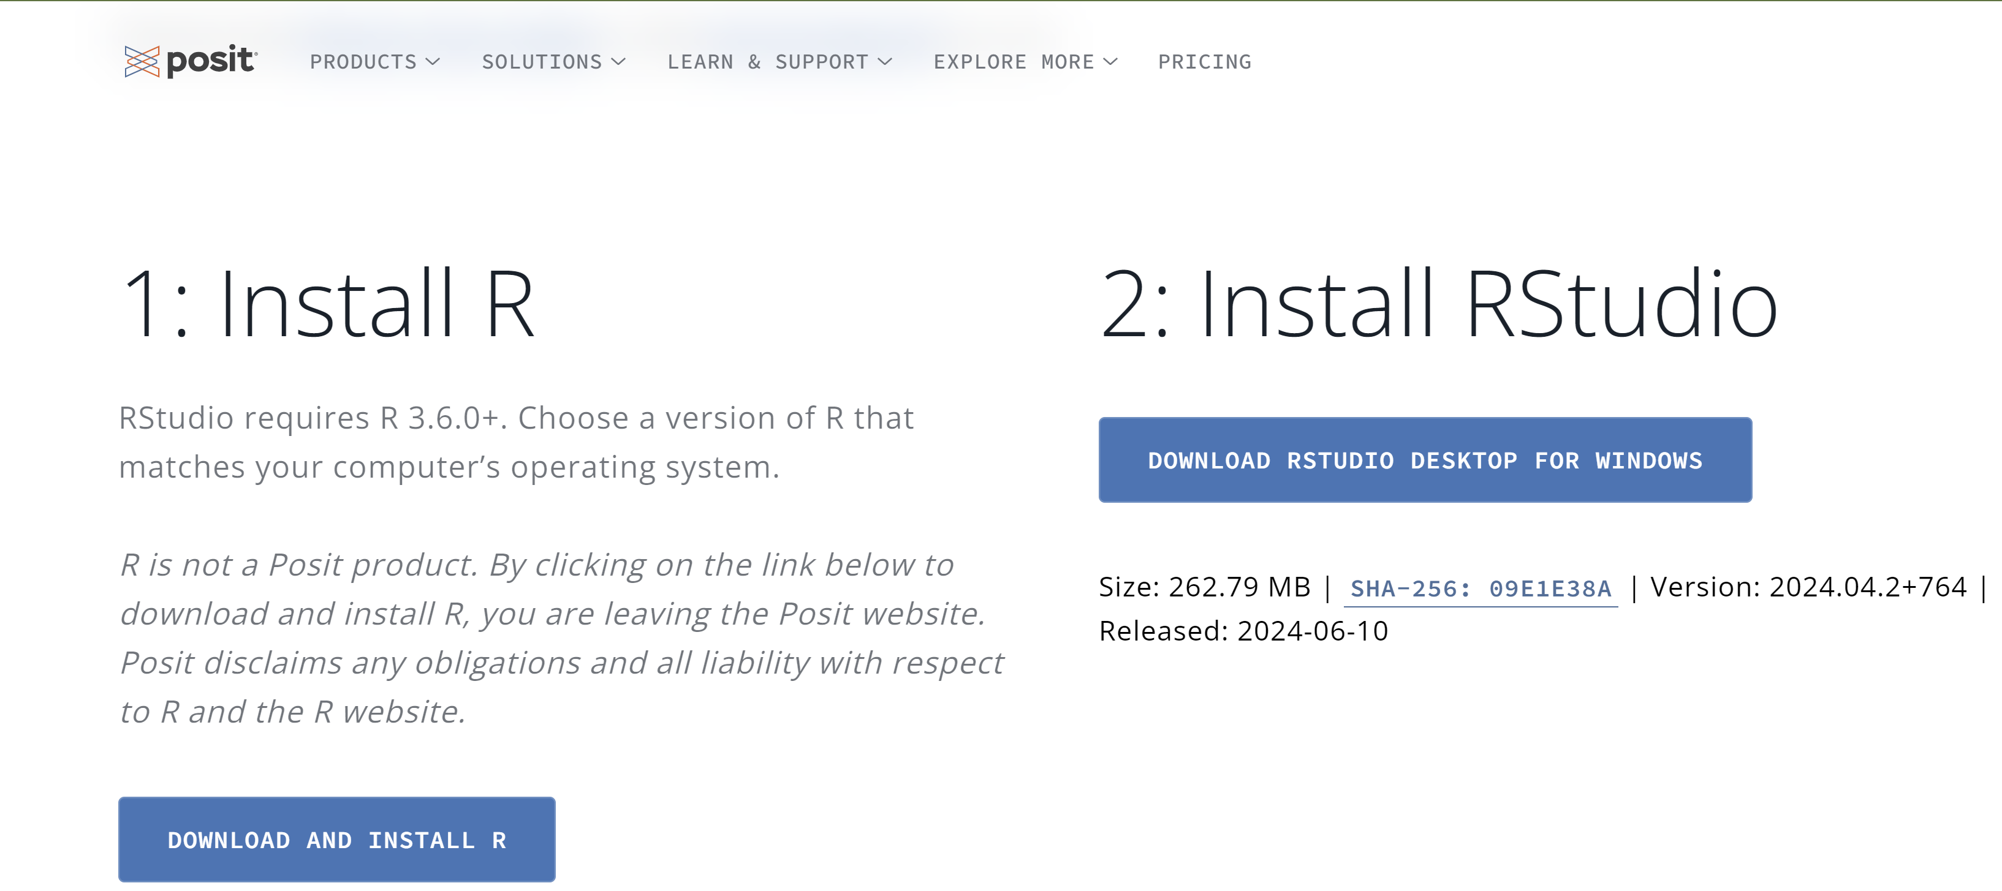
Installing R and RStudio
Step-by-step guide to installing R:
Visit CRAN:
https://cran.r-project.org and run the installer for your operating system (Windows, macOS, Linux).
Step-by-step guide to installing RStudio:
Visit RStudio:
https://posit.co/download/rstudio-desktop/ and run the installer for your operating system.

Slide 4
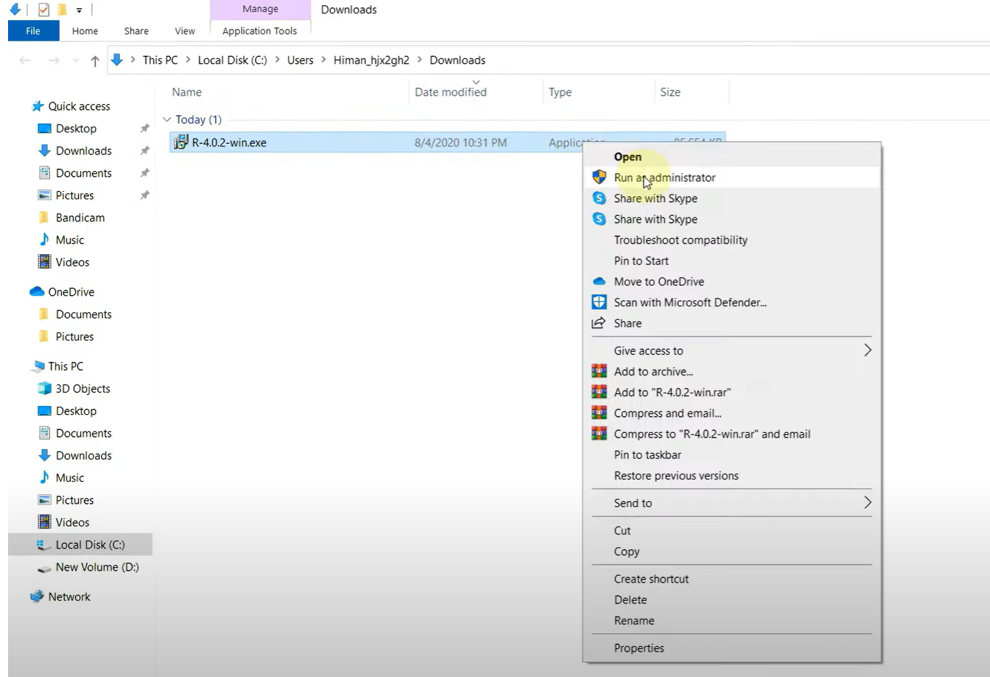
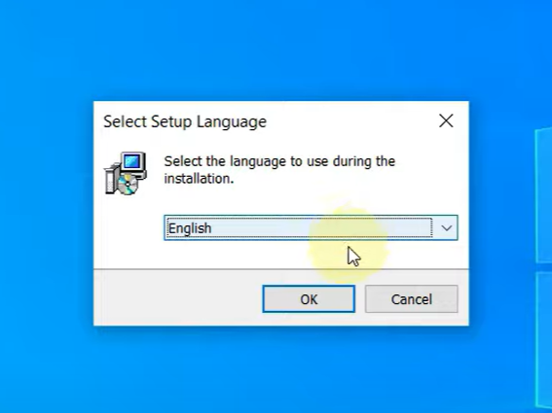
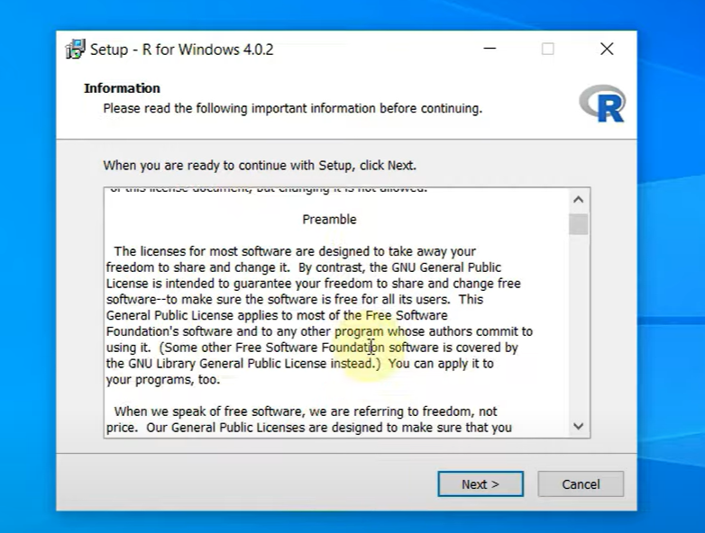
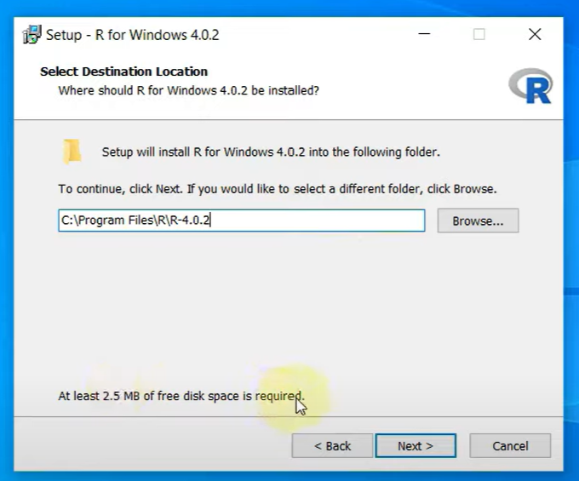
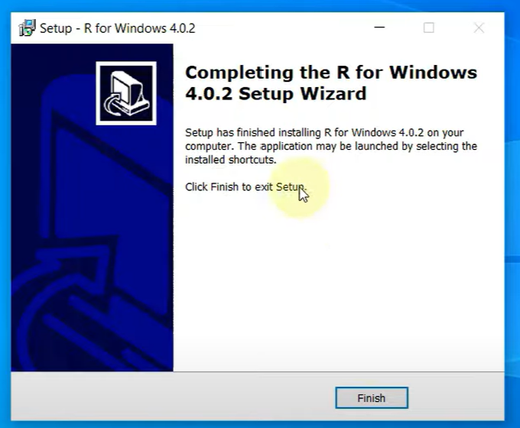
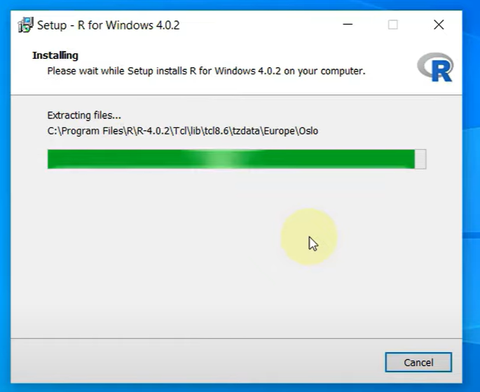
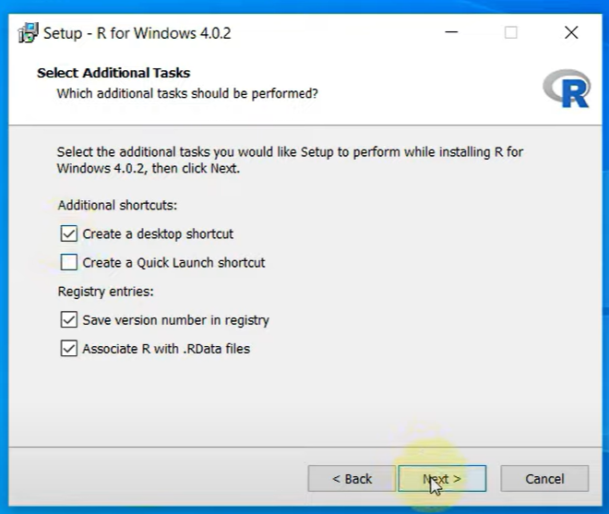
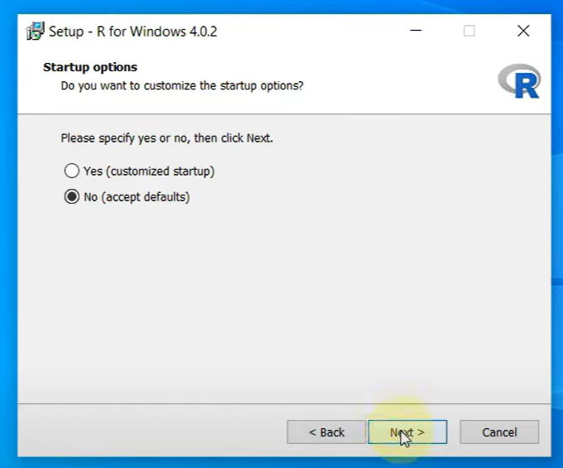
Installing R

Slide 5
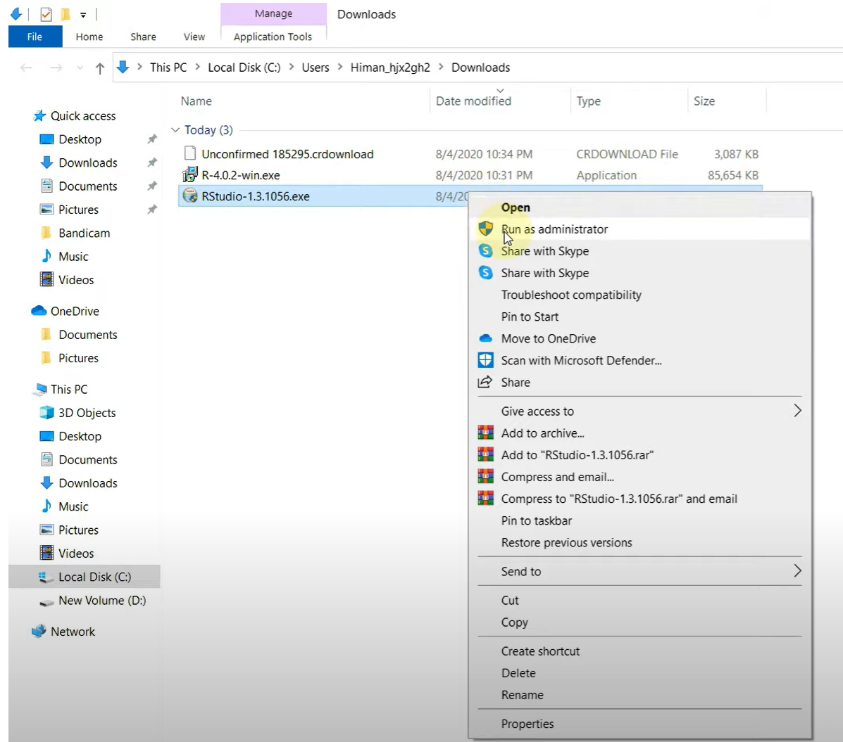
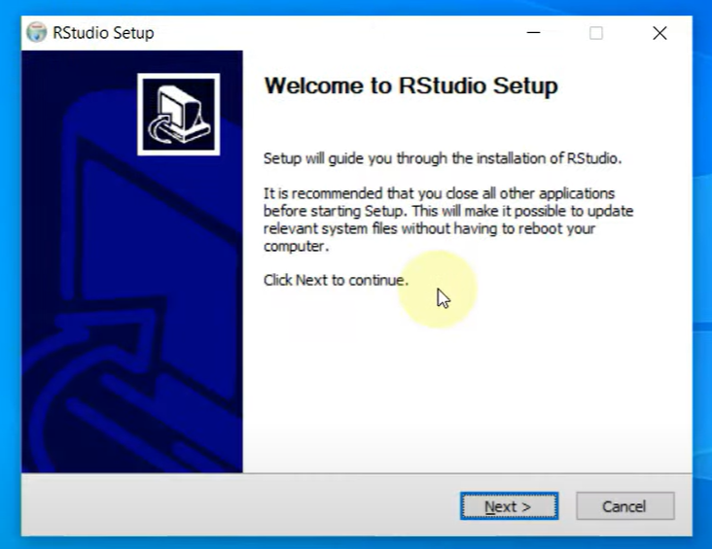
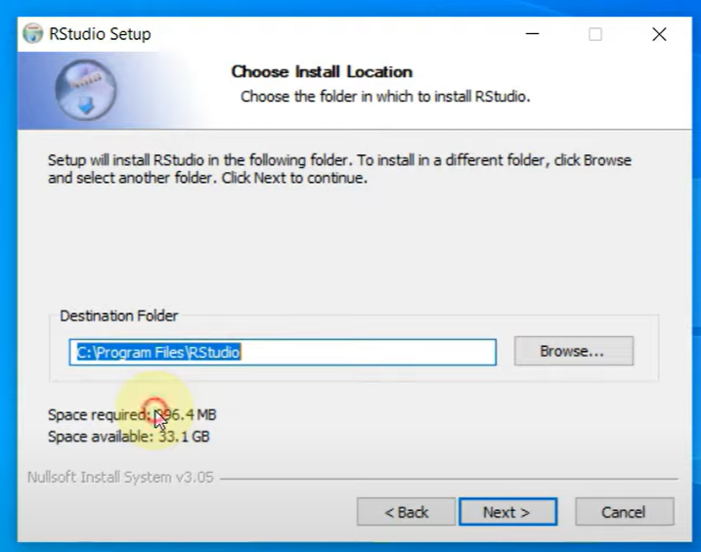
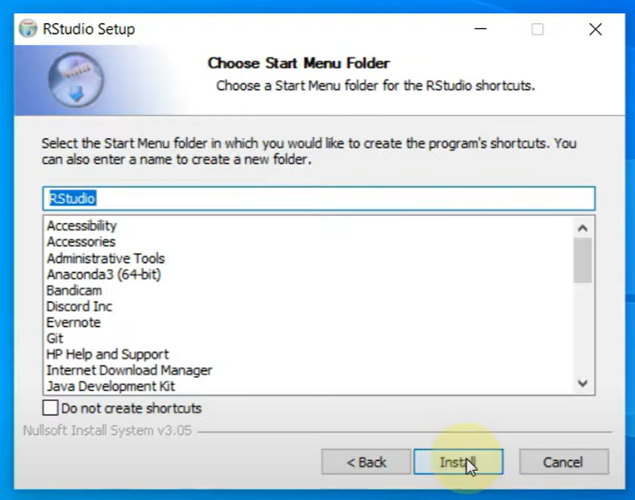
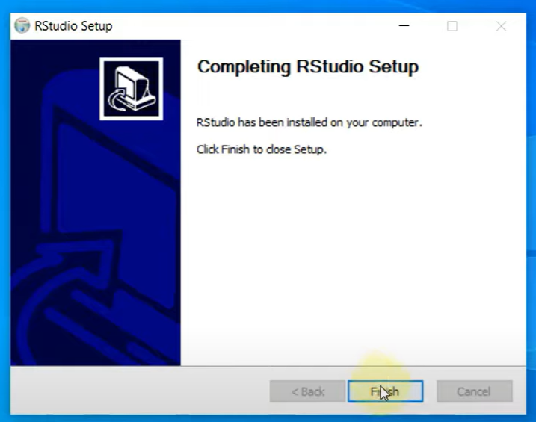
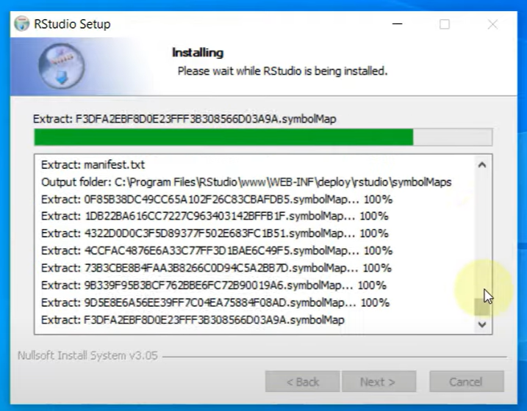
Installing RStudio

Slide 6
Navigating the RStudio Interface
Overview of RStudio layout:
Source pane: where you write your scripts.
Console pane: where you execute commands and see outputs.
Environment pane: shows your variables and data.
Files pane: manage your files and projects.
Run script
Environment pane
Source pane
files pane
Console pane
Basic RStudio shortcuts and tips:
Running code: Ctrl+Enter (Windows) / Cmd+Enter (Mac).
Commenting code: Ctrl+Shift+C (Windows) / Cmd+Shift+C (Mac).

Slide 7
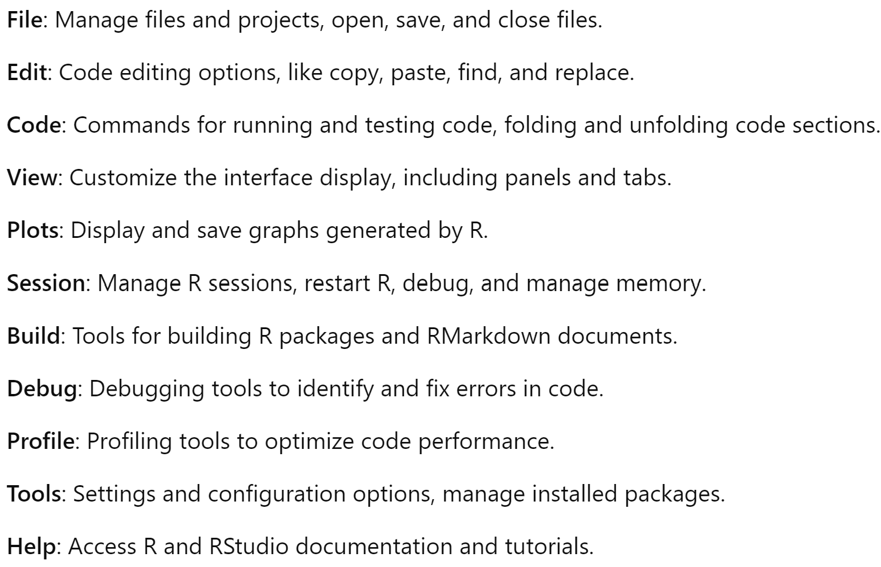
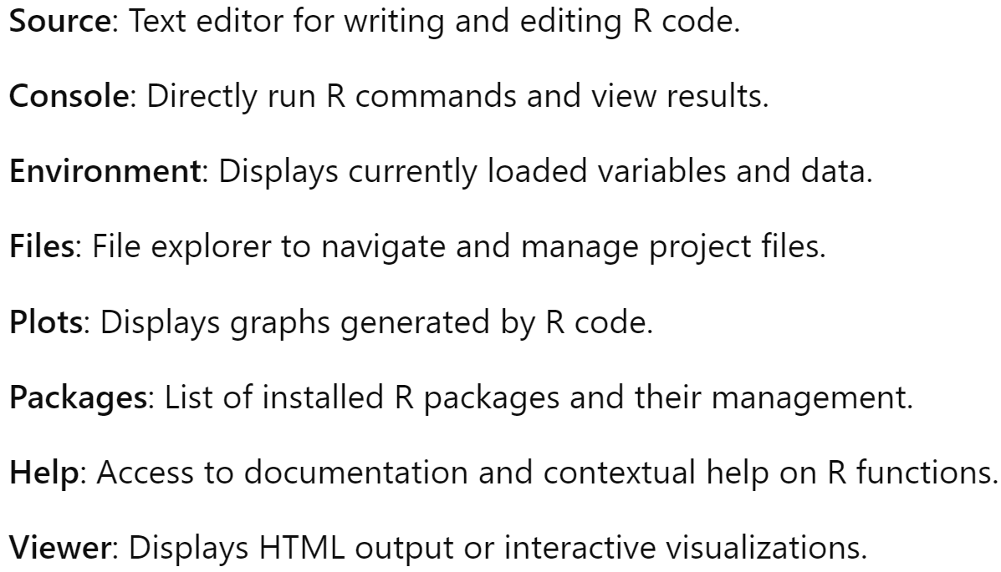
Navigating the RStudio Interface
Main menu
Panels and Sections

Slide 8
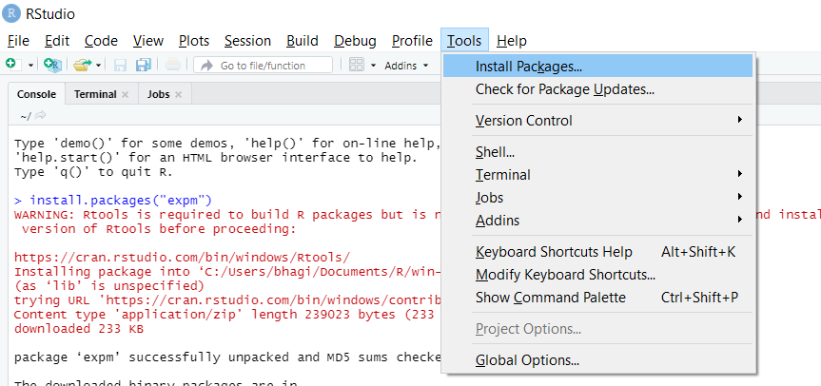
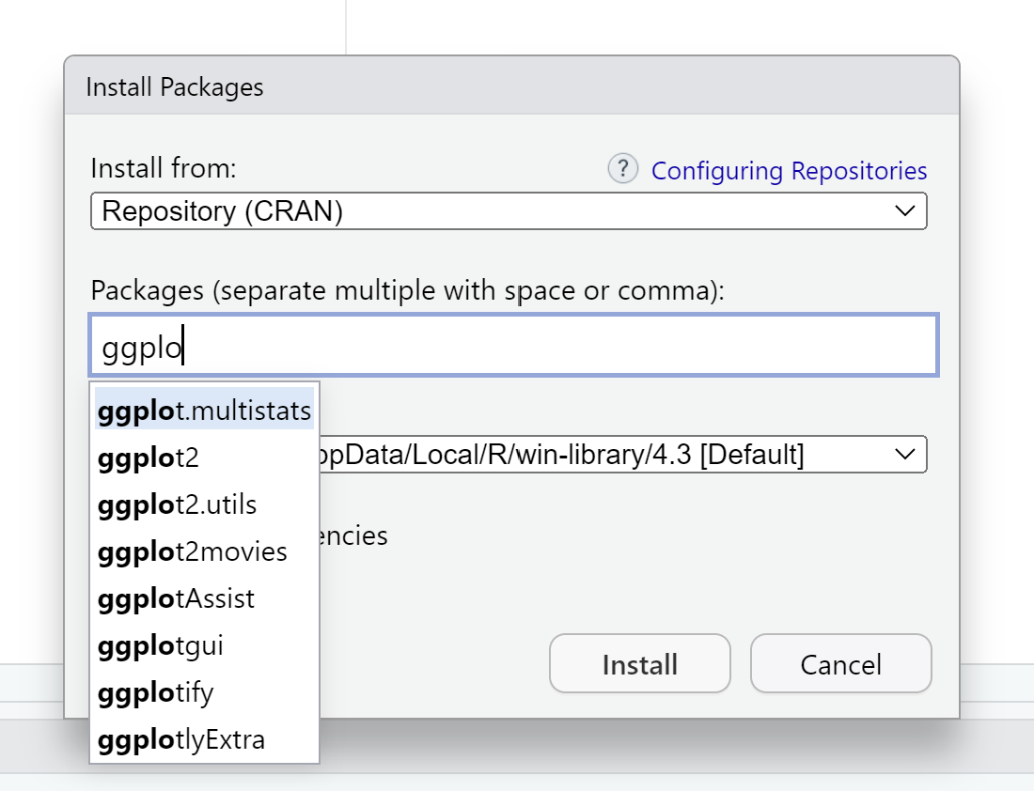
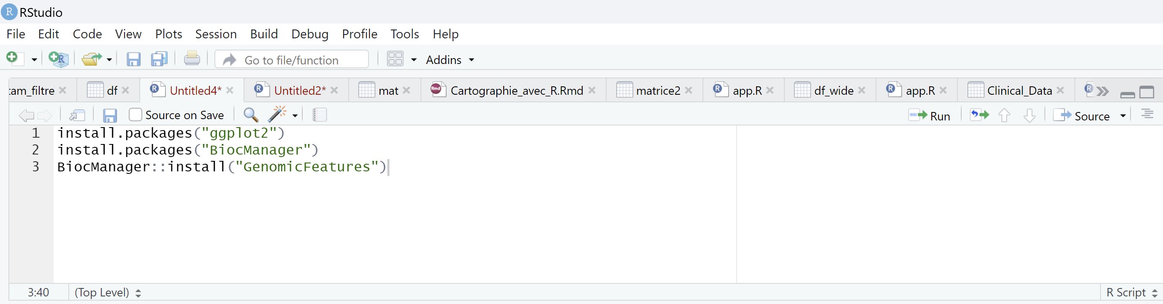
Installing Packages in R
Introduction to CRAN and Bioconductor:
CRAN: Comprehensive R Archive Network, primary repository for R packages.
Bioconductor: Specialized repository for bioinformatics packages.
Installing packages from CRAN:
Syntax: install.packages("package_name").
Example: install.packages("ggplot2").
Installing packages from Bioconductor:
Installing BiocManager: install.packages("BiocManager").
Using BiocManager to install packages: BiocManager::install("package_name").

Slide 9
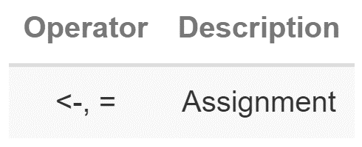
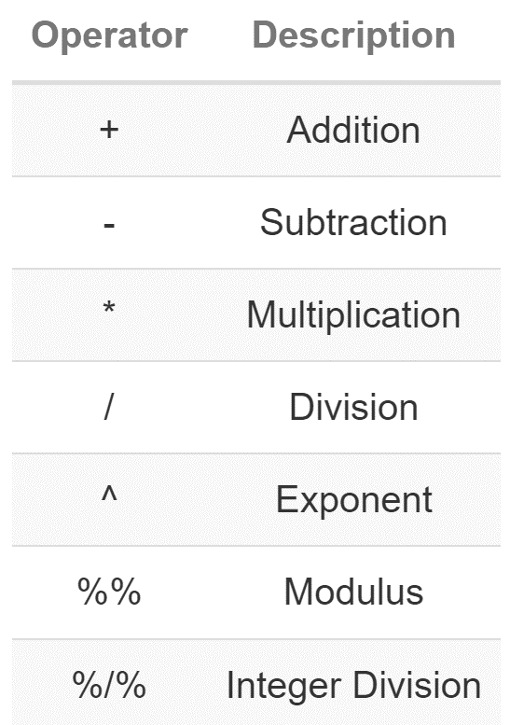
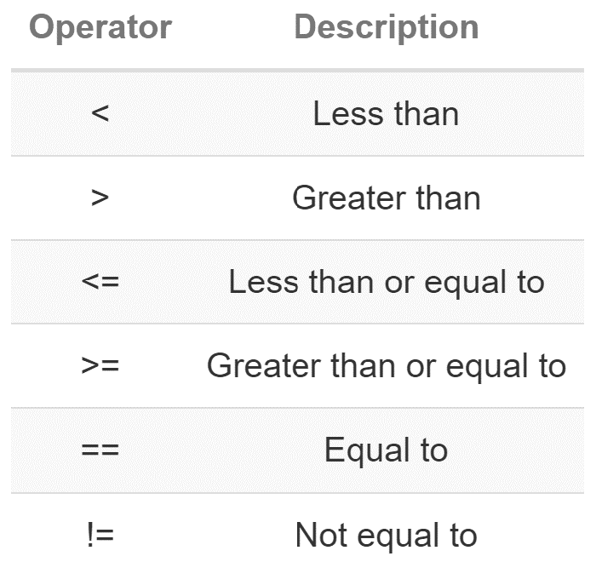
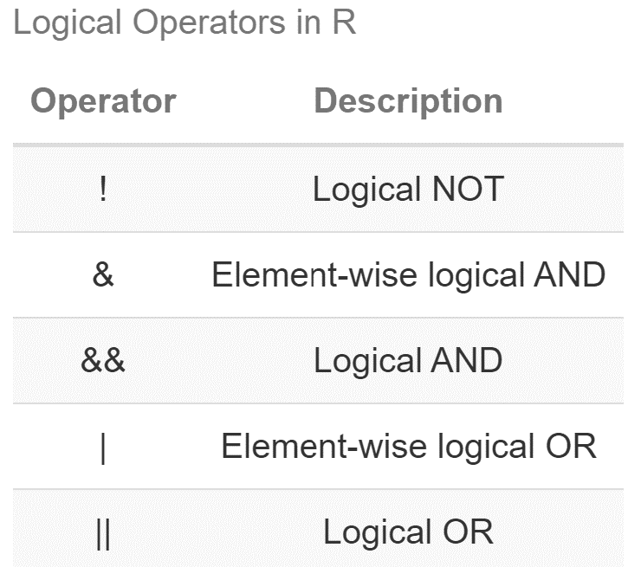
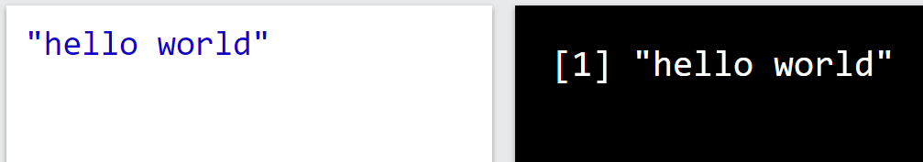
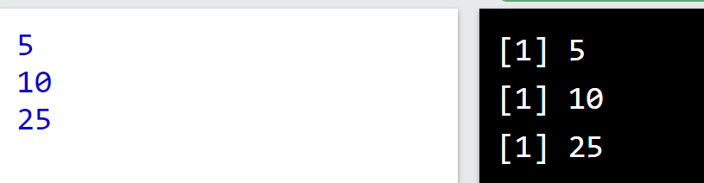
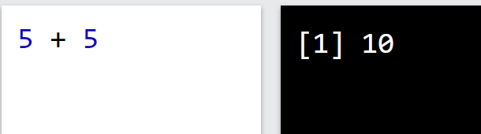
Operations - Syntax
Assignment Operators in R
Arithmetic Operators in R
Relational Operators in R
Logical Operators in R
R Syntax
To output text in R, use single or double quotes:
R Syntax
To output numbers, just type the number (without quotes):
R Syntax
To do simple calculations, add numbers together:

Slide 10
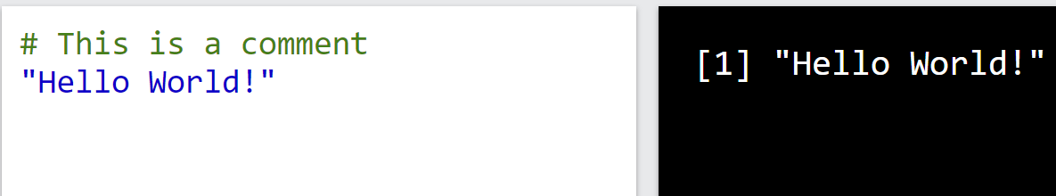
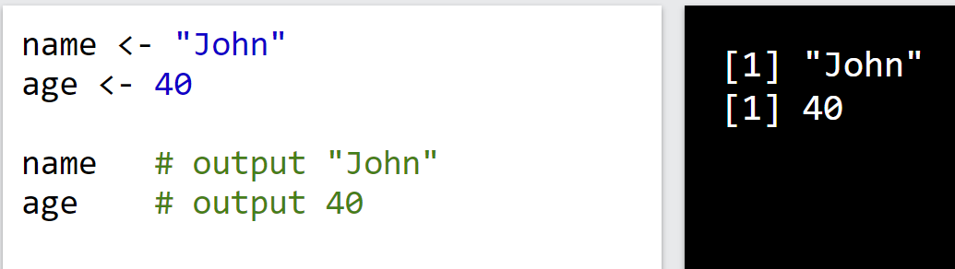
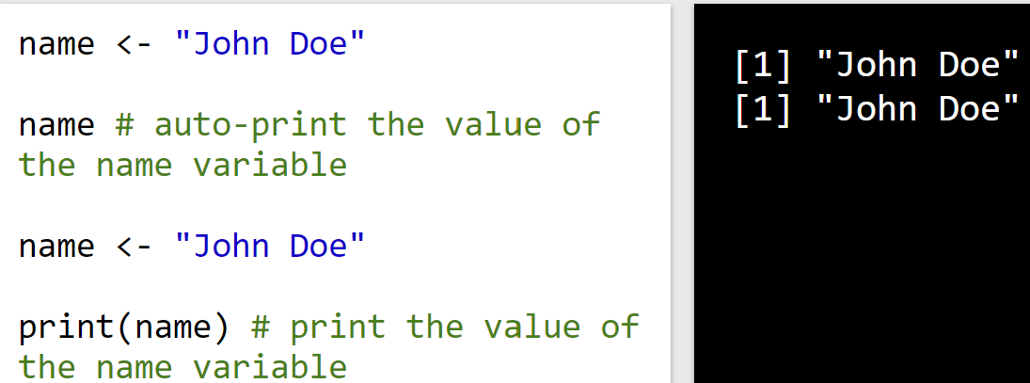
Comments
Comments:
Comments can be used to explain R code, and to make it more readable. It can also be used to prevent execution when testing alternative code.
Comments starts with a #. When executing code, R will ignore anything that starts with #.
Creating Variables in R
Variables are containers for storing data values.
R does not have a command for declaring a variable. A variable is created the moment you first assign a value to it. To assign a value to a variable, use the <- or = sign. To output (or print) the variable value, just type the variable name:
Print / Output Variables
To print the output, You can just type the name of the variable or use the print() function

Slide 11
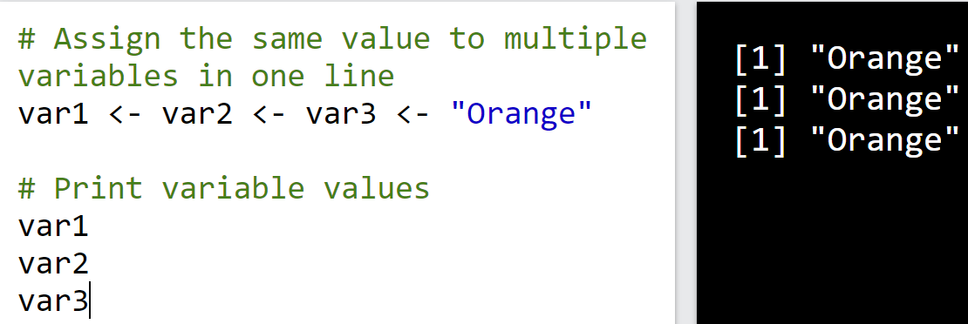
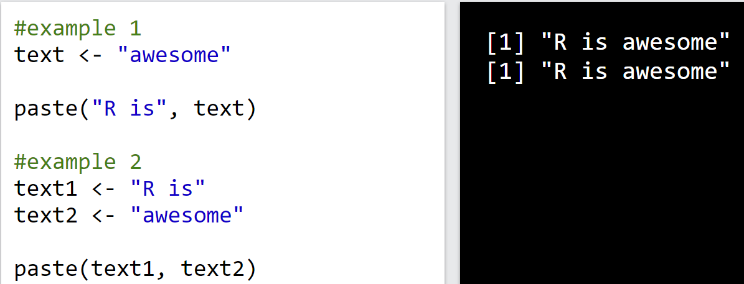
Variables
Concatenate Elements
You can also concatenate, or join, two or more elements, by using the paste() function.
To combine both text and a variable, R uses comma (,):
Multiple Variables
R allows you to assign the same value to multiple variables in one line:
Error
If you try to combine a string (text) and a number, R will give you an error:

Slide 12
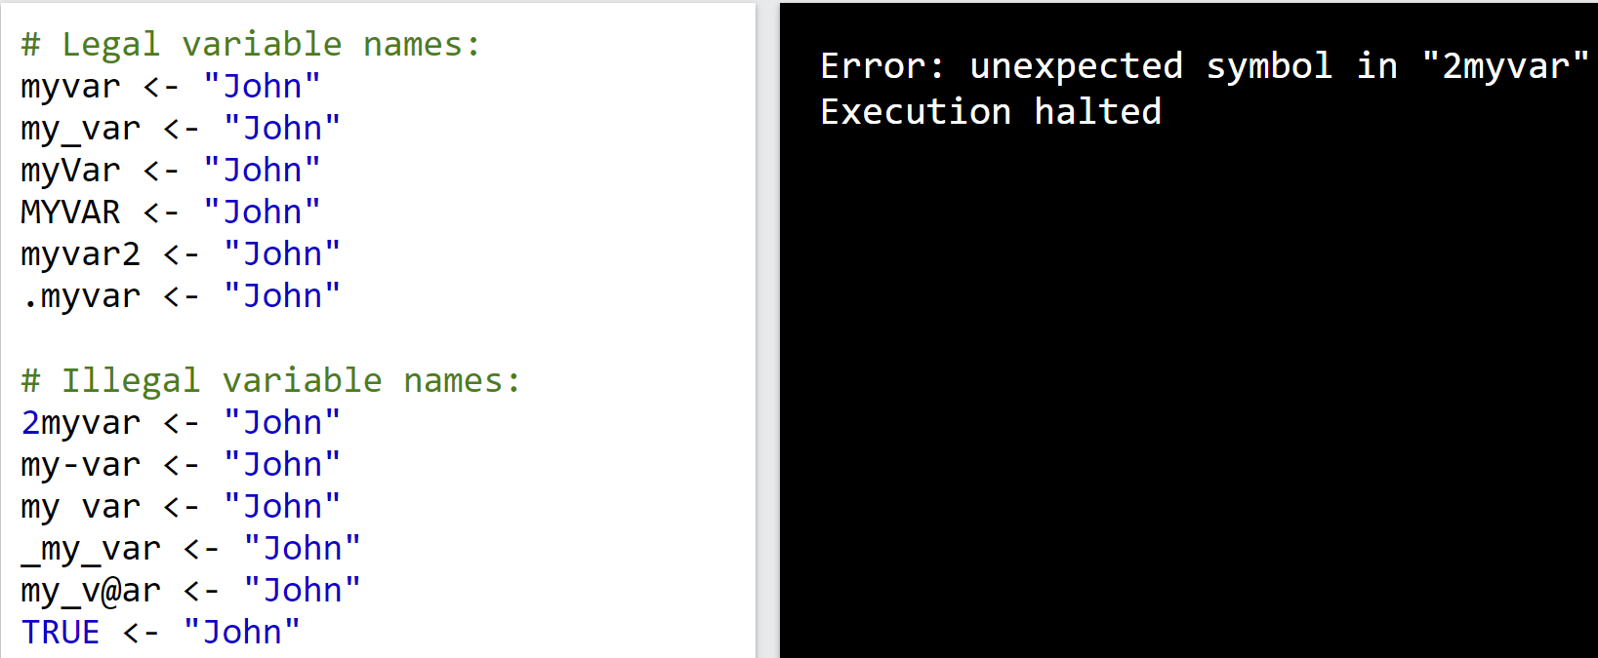
Variables
Variable Names
A variable can have a short name (like x and y) or a more descriptive name (age, carname, total_volume).
Rules for R variables are:
A variable name must start with a letter and can be a combination of letters, digits, period(.) and underscore(_). If it starts with period(.), it cannot be followed by a digit.
A variable name cannot start with a number or underscore (_)
Variable names are case-sensitive (age, Age and AGE are three different variables)
Reserved words cannot be used as variables (TRUE, FALSE, NULL, if...)

Slide 13
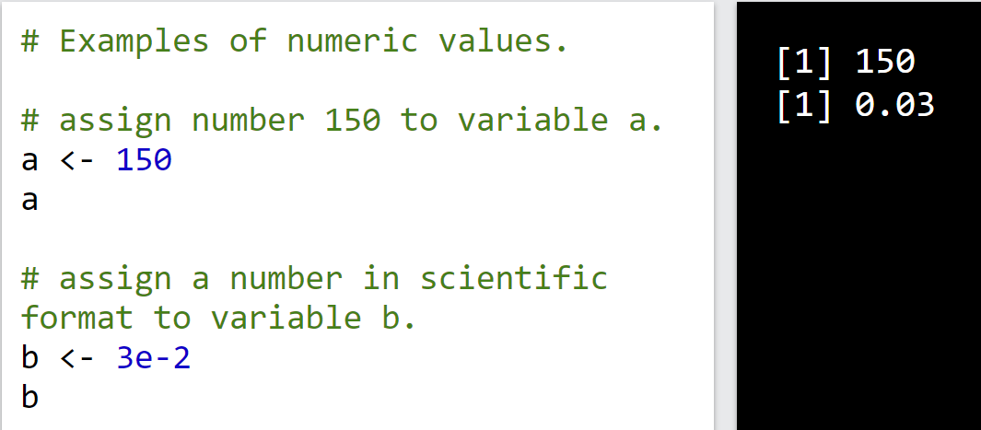
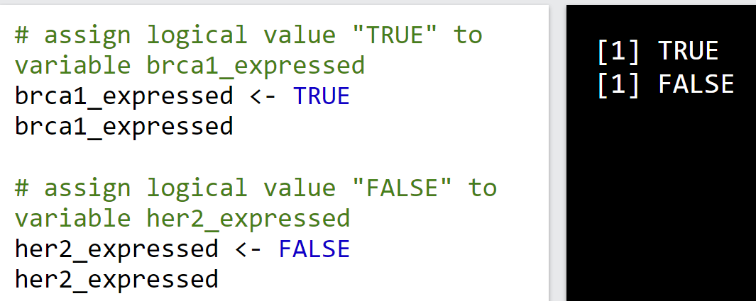
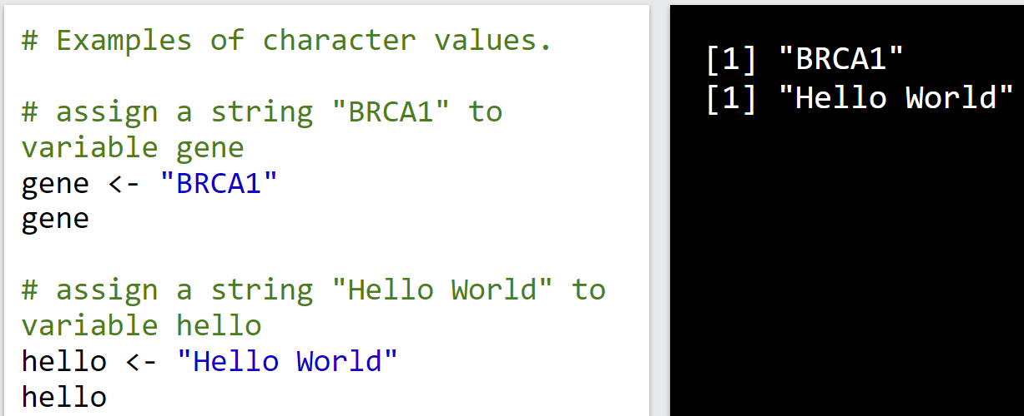
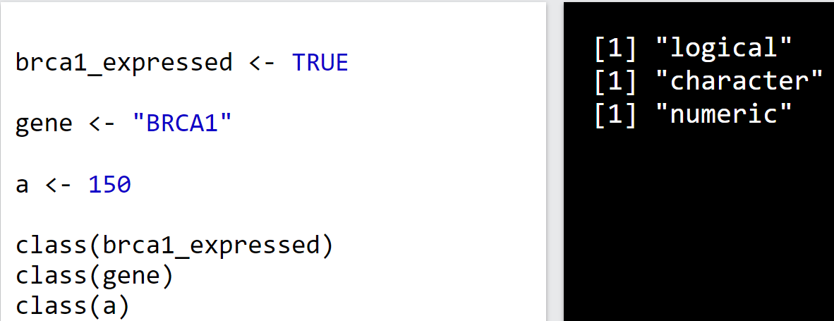
Data types
There are 5 basic atomic classes:
numeric
integer,
complex,
character,
Logical
A numeric data type contains any number with or without a decimal, like: 10.5, 55, 787
Integers are numeric data without decimals. To create an integer variable, you must use the letter L after the integer value: (ex: x <- 1000L)
A complex number is written with an "i" as the imaginary part: (ex: x = 3+5i)
Examples of numeric values
Example of logical values
To find out the type of variable, use the class() function
Example of character values

Slide 14
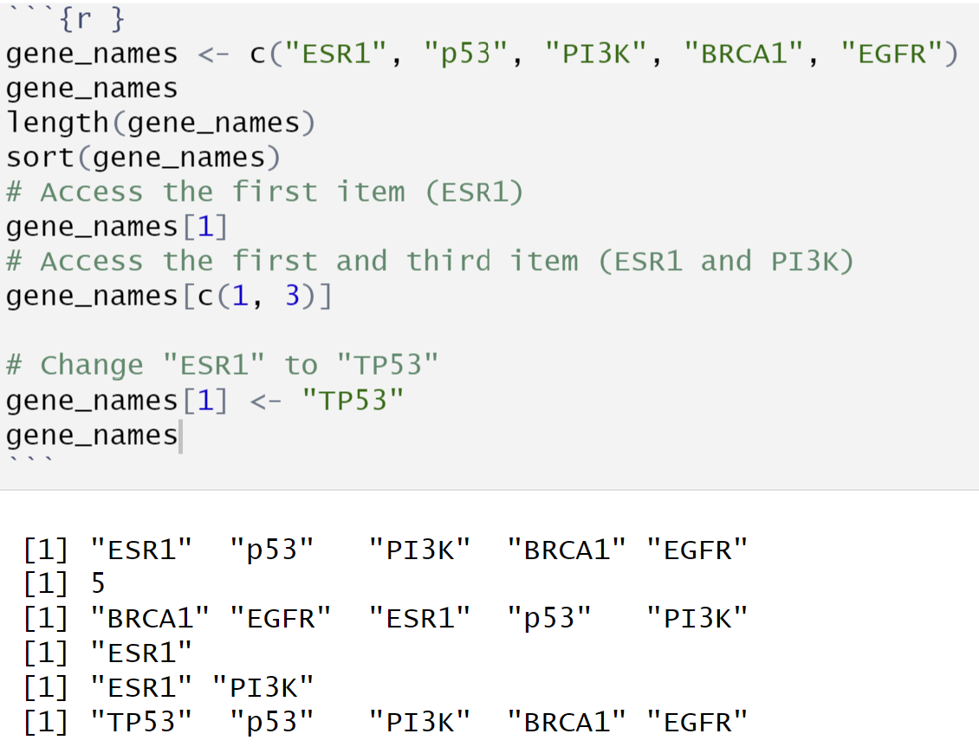
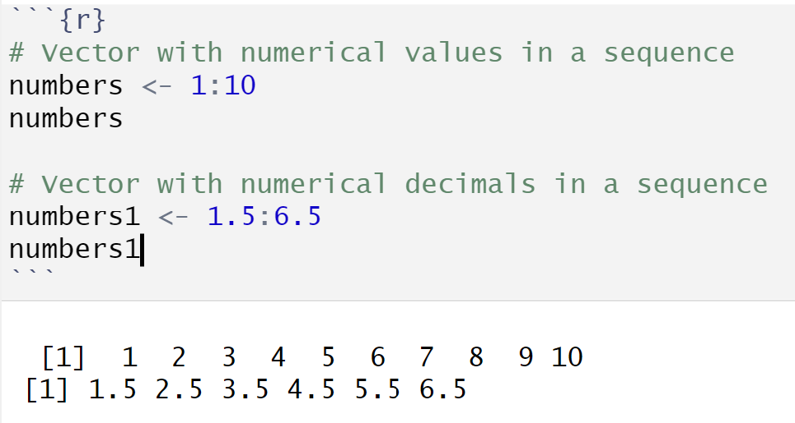
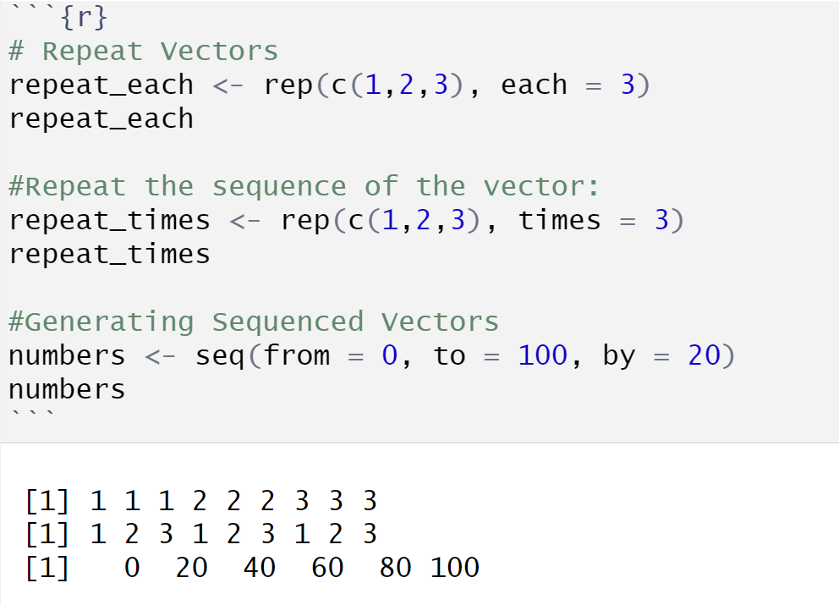
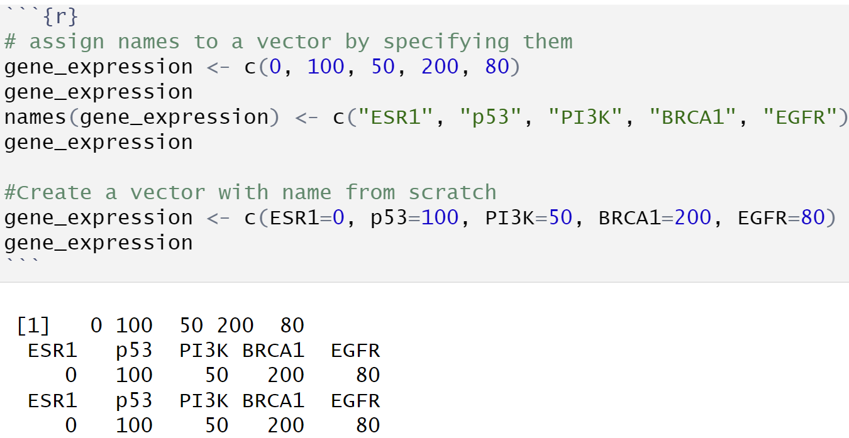
Data Structures: Vector
Creating Vectors: Using the c() function to combine items of the same type into a vector.
Ex: gene_names <- c("ESR1", "p53", "PI3K", "BRCA1")
Types of Vectors: Numerical, character, and logical vectors.
Vector Operations: Accessing, modifying, and sorting vector elements.
Vector Length and Repetition: Using length(), sort(), and rep() functions.
Sequences: Generating sequences using : and seq() functions.

Slide 15
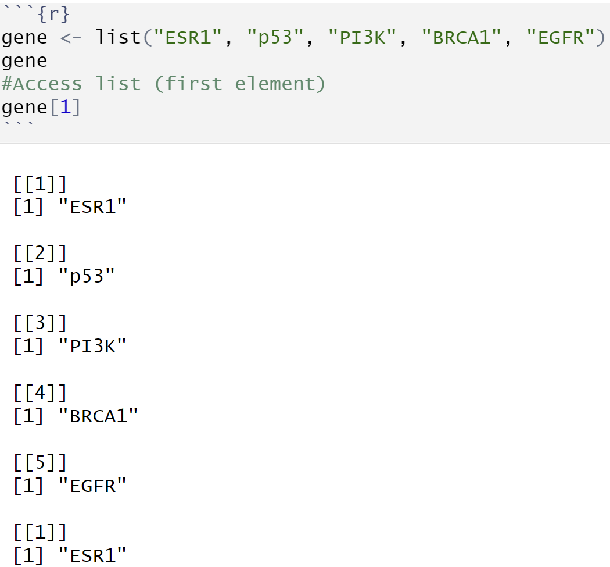
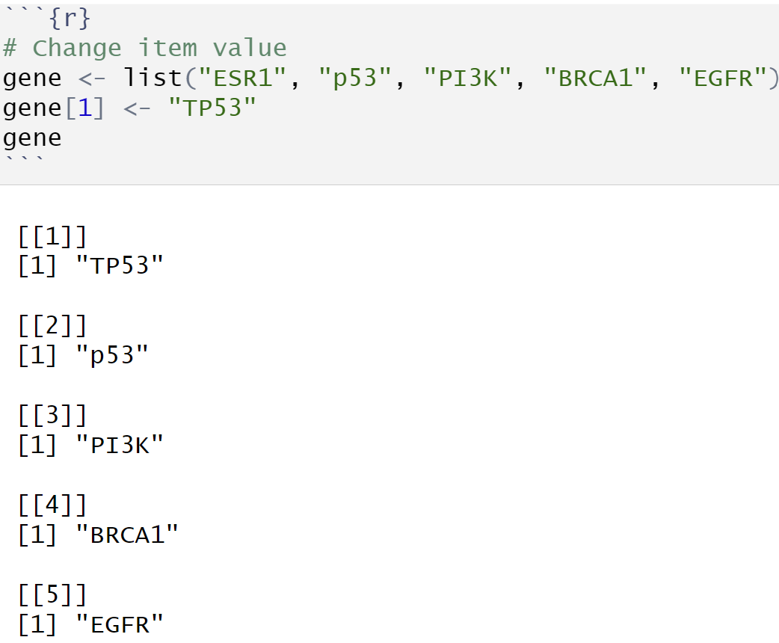
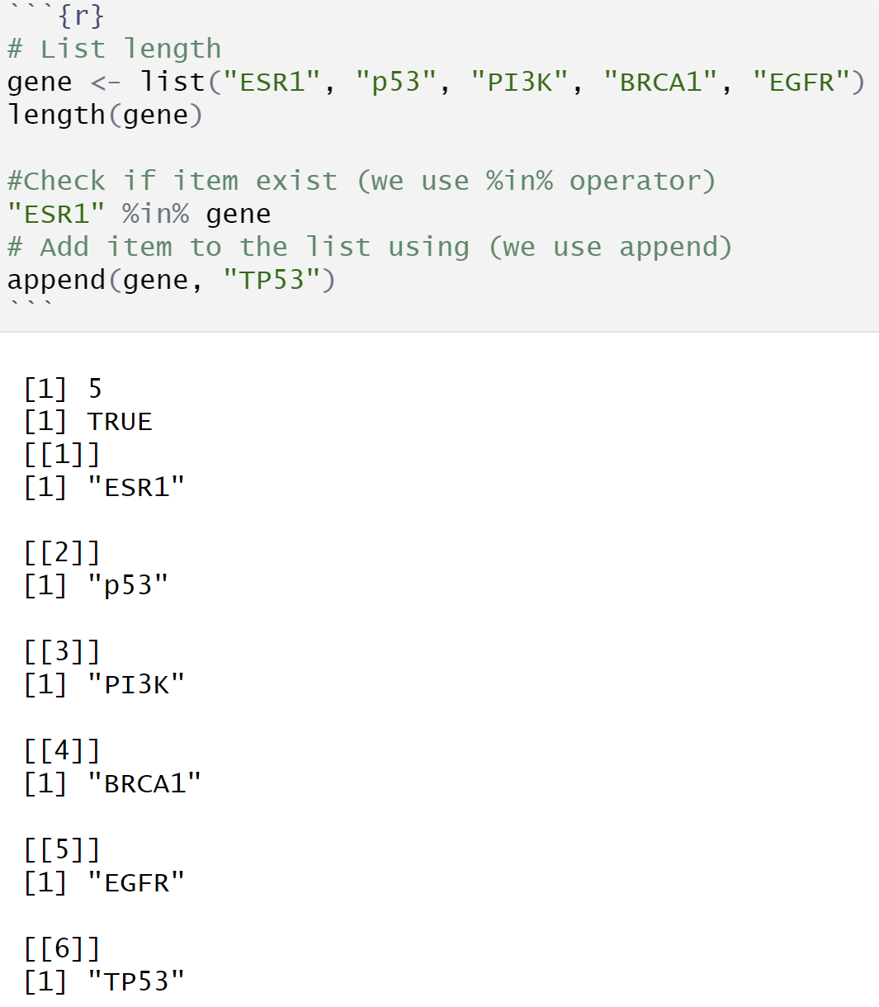
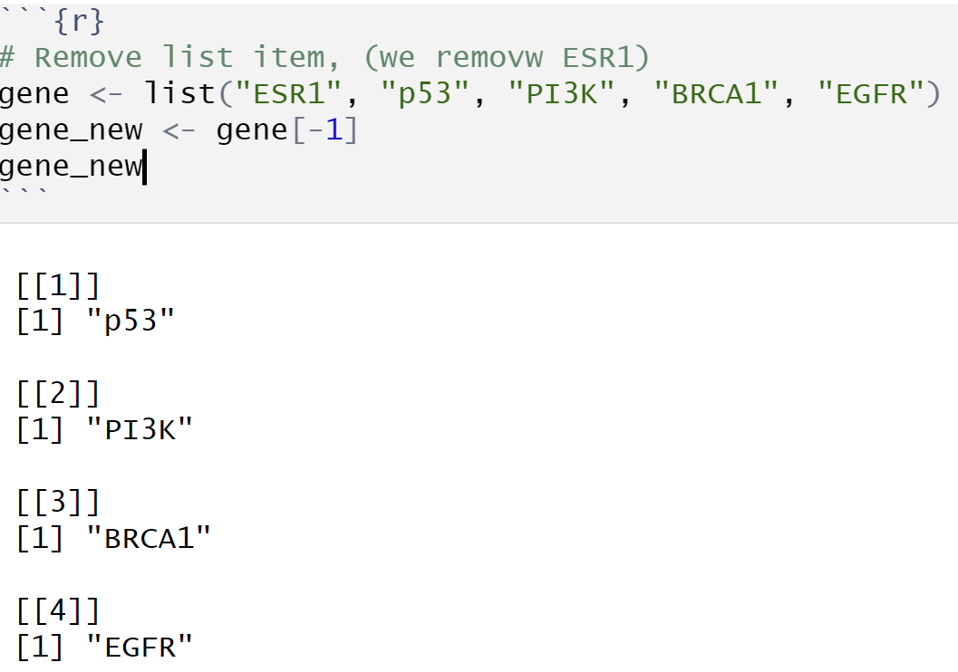
Data Structure: List
Lists
A list in R can contain many different data types inside it. A list is a collection of data which is ordered and changeable.
To create a list, use the list() function:

Slide 16
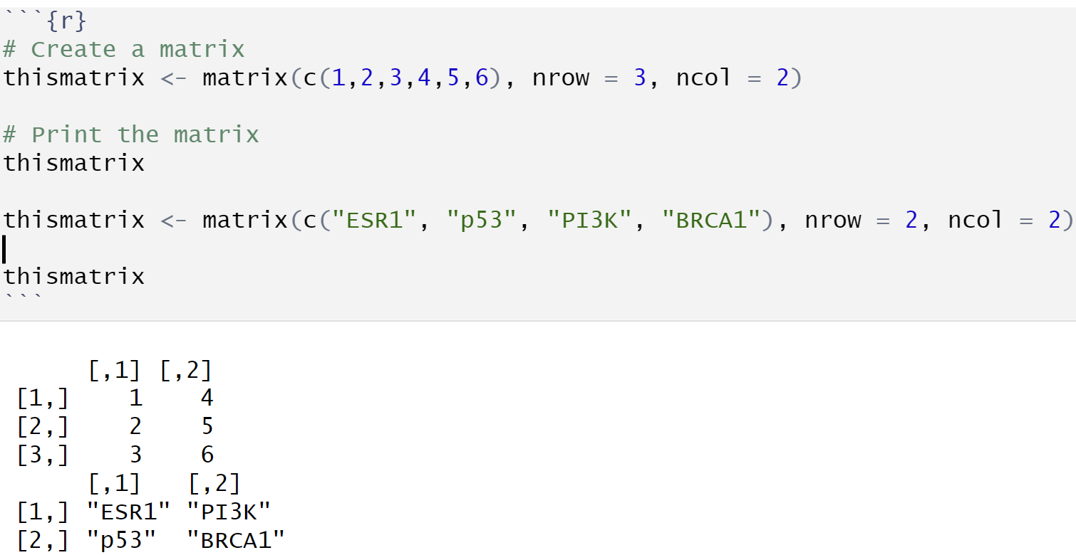
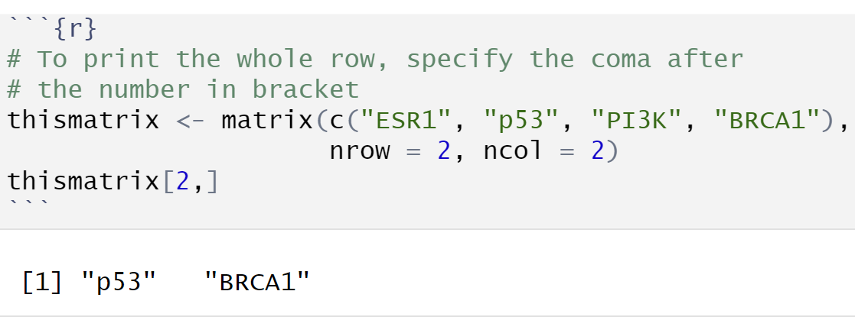
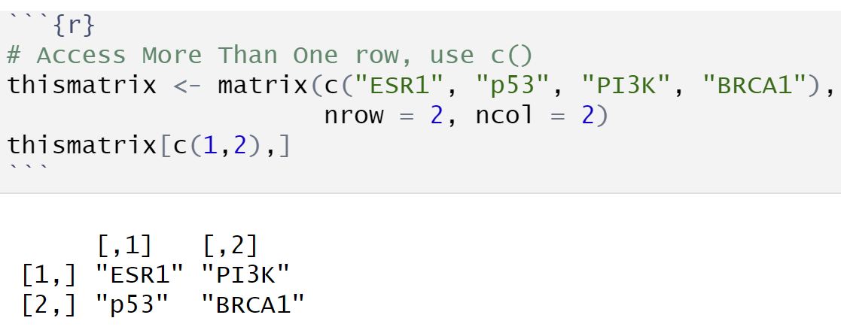



Data Structure: Matrice
Matrices
A matrix is a two dimensional data set with columns and rows.
A column is a vertical representation of data, while a row is a horizontal representation of data.
A matrix can be created with the matrix() function. Specify the nrow and ncol parameters to get the amount of rows and columns:
Print the whole row
Access more than one row
You can access the items by using [ ] brackets. The first number "1" in the bracket specifies the row-position, while the second number "2" specifies the column-position:
Print the whole column
Access more than one column

Slide 17




Data Structure: Matrice
Remove row and column
Add column
Check if an item exists
Add row

Slide 18


Data Structure: array
Arrays
Compared to matrices, arrays can have more than two dimensions.
We can use the array() function to create an array, and the dim parameter to specify the dimensions:
How does dim=c(4,3,2) work?
The first and second number in the bracket specifies the amount of rows and columns.
The last number in the bracket specifies how many dimensions we want.
Access Array Items
You can access the array elements by referring to the index position. You can use the [ ] brackets to access the desired elements from an array:
The syntax is as follow: array[row position, column position, matrix level]

Slide 19


Data Structure: array
Check if an Item Exists
To find out if a specified item is present in an array, use the %in% operator:
Access column or row
You can also access the whole row or column from a matrix in an array, by using the c() function:
A comma (,) before c() means that we want to access the column.
A comma (,) after c() means that we want to access the row.
Amount of Rows and Columns
Use the dim() function to find the amount of rows and columns in an array:
Array Length
Use the length() function to find the dimension of an array:

Slide 20


Data Structure: Data Frame
Data Frames
Data Frames are data displayed in a format as a table.
Data Frames can have different types of data inside it. While the first column can be character, the second and third can be numeric or logical. However, each column should have the same type of data.
Use the data.frame() function to create a data frame:
Summarize the Data
Use the summary() function to summarize the data from a Data Frame:

Slide 21



Data Structure: Data Frame
Access Items
We can use single brackets [ ], double brackets [[ ]] or $ to access columns from a data frame:
Add Rows
Use the rbind() function to add new rows in a Data Frame:
Add Columns
Use the cbind() function to add new columns in a Data Frame:

Slide 22


Data Structure: Data Frame
Remove Rows and Columns
Use the c() function to remove rows and columns in a Data Frame:
Number of rows and columns
You can also use the ncol() function to find the number of columns and nrow() to find the number of rows:
Example: ncol(Data_Frame)
nrow(Data_Frame)
Data Frame Length
Use the length() function to find the number of columns in a Data Frame (similar to ncol()):
Amount of Rows and Columns
Use the dim() function to find the amount of rows and columns in a Data Frame:
Example: dim(Data_Frame)

Slide 23


Data Structure: Data Frame
Combining Data Frames
Use the rbind() function to combine two or more data frames in R vertically:
And use the cbind() function to combine two or more data frames in R horizontally:

Slide 24


Data Structure: factors
Factors
Factors are used to categorize data. Examples of factors are:
Demography: Male/Female
desease: benign/malign
To create a factor, use the factor() function and add a vector as argument:
To only print the levels, use the levels() function:

Slide 25



Data Structure: factors
Factor Length
Use the length() function to find out how many items there are in the factor:
Access Factors
To access the items in a factor, refer to the index number, using [ ] brackets:
Change Item Value
To change the value of a specific item, refer to the index number:

Slide 26







Common Mistakes to Avoid in RStudio
Not Installing Packages:
Confusing Data Structures:
Incorrect Indexing:
Using = Instead of == for Comparison:
Confusing CRAN and Bioconductor for installing
Forgetting to Load Packages:
Forgetting Quotation Marks in Strings:

Slide 27


Essential R Packages
Overview of some essential R packages:
dplyr: Data manipulation.
ggplot2: Data visualization.
tidyr: Data tidying.
readr: Reading data.
shiny: Building interactive web applications.
How to load packages using library():
Example: library(ggplot2).
Searching for Help Within R
The help() function and ? operator are useful only if you already know the name of the function that you wish to use. Use the help system to obtain complete documentation for these functions:
for example, ?sum.

Slide 28


Reading Data into R
Method 1
Introduction to reading data into R:
Importance of importing data correctly for analysis.
Reading CSV files using read.csv():
Syntax: read.csv("file_path").
Example: data <- read.csv("data/sample.csv").
Reading Excel files using the readxl package:
Installing readxl: install.packages("readxl").
Syntax: read_excel("file_path").
Example: data <- read_excel("data/sample.xlsx").
Reading Txt files using readr package:
Installing readr: install.packages("readr").
Exemple: read_delim("data/sample.txt“, delim = “/t”)
Method 2

Slide 29

Writing Data from R
Writing data to CSV files using write.csv():
Syntax: write.csv(data, "file_path").
Example: write.csv(data, "data/output.csv").
Writing data to Excel files using the writexl package:
Installing writexl: install.packages("writexl").
Syntax: write_xlsx(data, "file_path").
Example: write_xlsx(data, "data/output.xlsx").

